Slide 1
Data Mining and Data Warehousing
Unit 7
Cluster analysis

Slide 2
Cluster Analysis
Cluster: a collection of data objects
Similar to one another within the same cluster
Dissimilar to the objects in other clusters
Cluster analysis
Finding similarities between data according to the characteristics found in the data and grouping similar data objects into clusters
Unsupervised learning: no predefined classes

Slide 3
Types of Data in Cluster Analysis
Binary variables
Nominal variables
Ordinal variables
Numeric attributes

Slide 4
Similarity and Dissimilarity Between Objects
Distances are normally used to measure the similarity or dissimilarity between two data objects
Some popular ones include: Minkowski distance:
where i = (x_{i1}, x_{i2}, …, x_{ip}) and j = (x_{j1}, x_{j2}, …, x_{jp}) are two p-dimensional data objects, and q is a positive integer
If q = 1, d is Manhattan distance

Slide 5
Similarity and Dissimilarity Between Objects…
If q = 2, d is Euclidean distance:
Properties
d(i,j) ≥ 0
d(i,i) = 0
d(i,j) = d(j,i)
d(i,j) ≤ d(i,k) + d(k,j)
Also, one can use weighted distance, parametric Pearson product moment correlation, or other disimilarity measures

Slide 6
Binary Variable
Object j
A contingency table for binary data
Distance measure for symmetric binary variables:
Distance measure for asymmetric binary variables:
Object i

Slide 7


Binary Variable (Example)…
Example
gender is a symmetric attribute
the remaining attributes are asymmetric binary
let the values Y and P be set to 1, and the value N be set to 0

Slide 8
Nominal Variable
A generalization of the binary variable in that it can take more than 2 states, e.g., red, yellow, blue, green
Method : Simple matching
m: # of matches, p: total # of variables (attributes)
Example
Here is only one attribute “Test Result”, so p=1
Id | Test Result
1 | Code A
2 | Code B
3 | Code C
4 | Code A
 | 1 | 2 | 3 | 4
1 | 0
2 | 1 | 0
3 | 1 | 1 | 0
4 | 0 | 1 | 1 | 0
Dissimilarity Matrix

Slide 9
Ordinal Variables
An ordinal variable can be discrete or continuous
Order is important, e.g., rank
Can be treated like interval-scaled
replace x_{if} by their rank
map the range of each variable onto [0, 1] by replacing i-th object in the f-th variable by
compute the dissimilarity using methods for interval-scaled variables

Slide 10
Ordinal Variables (Example)…
Given Data Set
Step 3:- Normalize the ranking
Z_{if} = (r_{if} - 1) / (M_{f} – 1)
Object ID | Test
1 | Excellent
2 | Fair
3 | Good
4 | Excellent
Fair(1) = (1-1)/(3-1) = 0
Good(2) = (2-1) / (3-1) = 0.5
Excellent(3) = (3-1)/(3-1) = 1
Distance Matrix (Using Manhattan Distance)
Step 1:- Count the states (M_{f})
Here M_{f} = 3, {Fair, Good, Excellent}
 | 1 | 2 | 3 | 4
1 | 0 | 1 | 0.5 | 0
2 |  | 0 | 0.5 | 1
3 |  |  | 0 | 0.5
4 |  |  |  | 0
Step 2:- Replace each ordinal data by rank
{Fair=1, Good=2, Excellent=3}

Slide 11
Numerical Attributes
Normalize the values d(i, j) = |x_{if} - x_{jf}| / (max - min)
Example
Id | Value
1 | 45
2 | 22
3 | 64
4 | 28
 | 1 | 2 | 3 | 4
1 | 0 | 0.55 | ? | ?
2 |  | 0 | 1 | 0.13
3 |  |  | 0 | 0.86
4 |  |  |  | 0
Here, max = 64 and min = 22
d(1, 2) = |45 – 22| / (64 - 22)
= 23 / 42
= 0.55

Slide 12
Clustering Techniques
Clustering techniques only.
Partitioning
k-Means algorithm
k-Medoids algorithm (PAM (Partitioning Around Medoids)
Hierarchical
Agglomerative and divisive algorithm
Density – Based
DBSCAN

Slide 13
k-Means Algorithm
k-Means clustering algorithm proposed by J. Hartigan and M. A. Wong [1979].
Given a set of n distinct objects, the k-Means clustering algorithm partitions the objects into k number of clusters such that intra-cluster similarity is high but the inter-cluster similarity is low.
In this algorithm, user has to specify k, the number of clusters and consider the objects are defined with numeric attributes and thus using any one of the distance metric to demarcate the clusters.

Slide 14
k-Means Algorithm…
Algorithm
Choose k number of clusters to be determined.
Choose k objects randomly as the initial cluster centers
Repeat
Assign each object to their closest cluster
Compute new clusters, calculate mean points
Until
No change in cluster entities OR
No objects change its clusters

Slide 15
k-Means Algorithm (Example, k=2)…

Slide 16
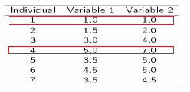
k-Means Algorithm (Example, k=2)…
Step 1:
Initialization: Randomly we choose following two centroids (k=2) for two clusters.
In this case the 2 centroids are: m1=(1.0,1.0) and m2=(5.0,7.0).

Slide 17

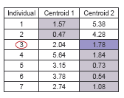

k-Means Algorithm (Example, k=2)…
Step 2:
Thus, we obtain two clusters containing: {1,2,3} and {4,5,6,7}.
Their new centroids are:
Therefore, the new clusters are:
{1,2} and {3,4,5,6,7}
Next centroids are: m1=(1.25,1.5) and m2 = (3.9,5.1)

Slide 18
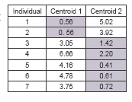
k-Means Algorithm (Example, k=2)…
Step 3:
The clusters obtained are:
{1,2} and {3,4,5,6,7}
Therefore, there is no change in the cluster.
Thus, the algorithm comes to a halt here and final result consist of 2 clusters {1,2} and {3,4,5,6,7}.

Slide 19
k-Means Algorithm… (Example)
Instance | X | Y
1 | 1.0 | 1.5
2 | 1.0 | 4.5
3 | 2.0 | 1.5
4 | 2.0 | 3.5
5 | 3.0 | 2.5
6 | 3.0 | 4.0
If the objects are to be partitioned into 2 clusters then k = 2.
Next choose two points are random, object 1 and 3 are chosen,
i.e. C₁ = (1.0, 1.5) and C₂ = (2.0, 1.5)

Slide 20
Problems in k-Means
Weakness
Applicable only when mean is defined, then what about categorical data?
Need to specify k, the number of clusters, in advance
Unable to handle noisy data and outliers

Slide 21
K-Means ++
An initialization procedure for k-means
Acknowledge that there might be better choice for initial centroids
Instead of choosing initial clusters centers randomly, choose them smarter
Steps
Choose one of the data points as an initial cluster center
For each observation x, determine D(x), where D(x) denotes the minimal distance from x to a current cluster center
Choose next cluster center from the data points , with the probability of making an observation x, a cluster center, proportional to d(x)².
Repeat 2 and 3 until you have chosen the k number of centers

Slide 22
K-Means ++ (Example)…
Consider the data set
(7,4), (8,3), (5,9), (3,3), (1,3), (10,1), with k=3
Randomly select one data point, (7,4), as initial cluster center
X | D(x)
(7,4) | -
(8,3) | 2
(5,9) | 29
(3,3) | 17
(1,3) | 37
(10,1) | 18
Prob
-
2/103
29/103
17/103
37/103
18/103
D(x)
-
2
29
4
-
18
Prob
-
2/53
29/53
4/53
-
18/53
The algorithm terminates here, since we have to make 3 (k=3) clusters and we have chosen 3 centers (7,4), (1,3), (5,9)
Having highest probability

Slide 23
K-Means ++ (Exercise)…
Use the k-means++ algorithm and Euclidean distance to find the first K(=3) centroids from the following 8 examples :
A1=(2,10), A2=(2,5), A3=(8,4), A4=(5,8), A5=(7,5), A6=(6,4), A7=(1,2), A8=(4,9).
Assume that the first point chosen as centroid is A7

Slide 24
Mini Batch K - Means
Alternative of K-means for clustering massive dataset
At each iteration, use small random subsets of data (“mini batches”)
No need to store the whole dataset in memory
At each iteration, only the distance between a mini batch and k centroids need to be computed
i.e. at each iteration, only needs to have a subset of data (mini batch) and the k centroids in memory
So the advantage of this approach is to reduce the computational cost by not using all the dataset each iteration, but a sample of fix size

Slide 25
Mini Batch K – Means…
Main idea is to use small random batches of examples of a fixed size so they can be stored in memory
Each iteration a new random sample from the dataset is obtained and used to update the clusters and this is repeated until convergence
Each mini batch updates the clusters using a convex combination of the values of the prototypes and the examples, applying a learning rate that decreases with the number of iterations
This learning rate is the inverse of number of examples assigned to a cluster during the process
As the number of iterations increases, the effect of new examples is reduced, so convergence can be detected when no changes in the clusters occur in several consecutive iterations

Slide 26
Mini Batch K – Means…
Of course, the cost at this time is that the accuracy of our clustering will also be somewhat reduced (but in acceptable range)
In Mini Batch K-Means, we will choose an appropriate batch size, and we only use batch size samples for K-Means clustering
So how did this batch size sample come from?
It is generally obtained through random sampling without replacement
In order to increase the accuracy of the algorithm, we generally run the Mini Batch K-Means algorithm several times, use different random sampling sets to obtain clusters, and select the optimal cluster

Slide 27

k-Medoids
Minimize the sensitivity of k-means to outliers
Pick actual objects to represent clusters instead of mean values
Each remaining object is clustered with the representative object (Medoid) to which is the most similar
The algorithm minimizes the sum of the dissimilarities between each object and its corresponding reference point
E: the sum of absolute error for all objects in the data set
P: the data point in the space representing an object
O_{i}: is the representative object of cluster C_{i}

Slide 28
k-Medoids…
Initial representatives are chosen randomly
The iterative process of replacing representative objects by no representative objects continues as long as the quality of the clustering is improved
For each representative Object O
For each non-representative object R, swap O and R
Choose the configuration with the lowest cost

Slide 29
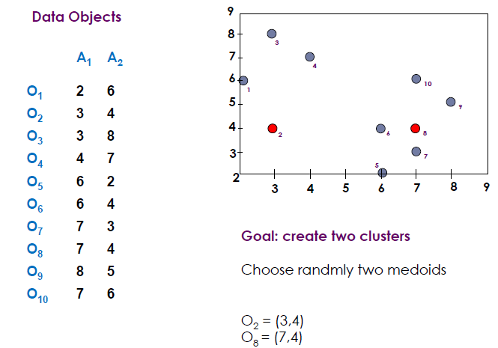
k-Medoids : Example

Slide 30
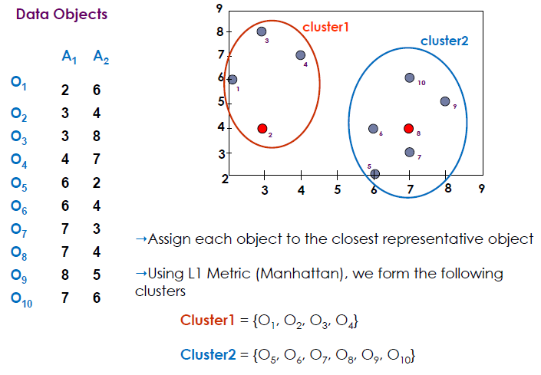
k-Medoids : Example…

Slide 31
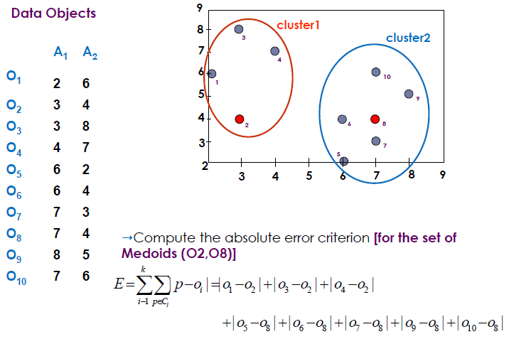
k-Medoids : Example…
Since 22>20 it is bad idea to
swap O₈ with O₇
Now let us swap O₇ with O₈
Error(O₂,O₇)=(3+4+4)+(2+2+1+3+3)=22
Error(O₂,O₈)=(3+4+4)+(3+1+1+2+2)=20

Slide 32
DBSCAN: Density Based Spatial Clustering of Applications with Noise
Two parameters:
Eps: Maximum radius of the neighbourhood
MinPts: Minimum number of points in an Eps-neighbourhood of that point
N_{Eps}(p): {q belongs to D | dist(p,q) <= Eps}
Directly density-reachable: A point p is directly density-reachable from a point q w.r.t. Eps, MinPts if
p belongs to N_{Eps}(q)
core point condition:
|N_{Eps} (q)| >= MinPts
p
MinPts = 5
Eps = 1 cm
q

Slide 33
Density-Reachable and Density-Connected
Density-reachable:
A point p is density-reachable from a point q w.r.t. Eps, MinPts if there is a chain of points p₁, …, p_{n}, p₁ = q, p_{n} = p such that p_{i+1} is directly density-reachable from p_{i}
Density-connected
A point p is density-connected to a point q w.r.t. Eps, MinPts if there is a point o such that both, p and q are density-reachable from o w.r.t. Eps and MinPts
p
p₁
q
p
q
o

Slide 34
DBSCAN…
Relies on a density-based notion of cluster: A cluster is defined as a maximal set of density-connected points
Discovers clusters of arbitrary shape in spatial databases with noise
Outlier
Border
Eps = 1cm
MinPts = 5
Core

Slide 35
DBSCAN: The Algorithm
Arbitrary select a point p
Retrieve all points density-reachable from p w.r.t. Eps and MinPts.
If p is a core point, a cluster is formed.
If p is a border point, no points are density-reachable from p and DBSCAN visits the next point of the database.
Continue the process until all of the points have been processed.

Slide 36
DBSCAN: Example
D is Core Point
Consider the following distance matrix
 | A | B | C | D | E | F
A | 0 | 0.7 | 4.9 | 3.6 | 4.2 | 3.2
B | 0.7 | 0 | 5.7 | 2.9 | 3.5 | 2.5
C | 5.7 | 4.9 | 0 | 2.2 | 1.4 | 2.5
D | 3.6 | 2.9 | 2.2 | 0 | 1 | 0.5
E | 4.2 | 3.5 | 1.4 | 1 | 0 | 1.1
F | 3.2 | 2.5 | 2.5 | 0.5 | 1.1 | 0
Epsilon = 1.5, MinPts = 3
Now find the number of points whose
distance <=1.5
For A, (A,A) = 0, (A,B) = 0.7, are only <=1.5,
the number is 2 (<MinPts), so A is either
border point or noise
E is Core Point and similarly F is also core point
Now, we have to determine whether A, B, C are either Noise or Border point
For C, two distance <= 1.5 are 0(with C itself) and 1.4 (With E), and E is a core point,
so C is border point
But B and A are Noise

Slide 37
DBSCAN: Exercise
If epsilon = 2 and MinPts = 2, what are the clusters that DBSCAN would discover and also find the core points, border point and outliers from the following data set
A1(2,10), A2(2,5), A3(8,4), A4(5,8), A5(7,5), A6(6,4), A7(1,2), A8(4,9)
Two Clusters, C1 = {A4, A8}, C2 = {A3, A5, A6}
Outliers :- A1, A2, A7

Slide 38
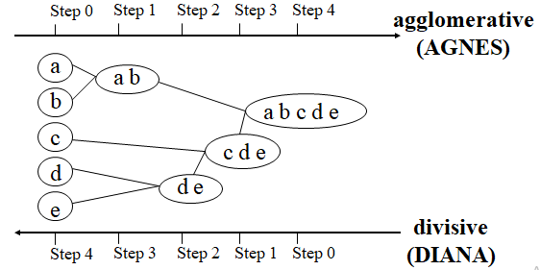
Hierarchical Clustering
Use distance matrix as clustering criteria. This method does not require the number of clusters k as an input, but needs a termination condition

Slide 39
Hierarchical Clustering…
Start with one cluster, individual item in its own cluster and iteratively merge clusters until all items belong to one cluster
Bottom up approach is followed to merge the clusters together
Dendograms are pictorially used to represent Hierarchical clustering

Slide 40
Hierarchical Clustering…
Hierarchical clustering is characterized by the development of a hierarchy or tree-like structure.
-Agglomerative clustering starts with each object in a separate cluster. Clusters are formed by grouping objects into bigger and bigger clusters.
-Divisive clustering starts with all the objects grouped in a single cluster. Clusters are divided or split until each object is in a separate cluster.
Agglomerative methods are commonly used in marketing research. They consist of linkage methods, variance methods, and centroid methods.

Slide 41
Hierarchical Clustering…
The single linkage method is based on minimum distance, or the nearest neighbor rule.
The complete linkage method is based on the maximum distance or the furthest neighbor approach.
The average linkage method the distance between two clusters is defined as the average of the distances between all pairs of objects

Slide 42
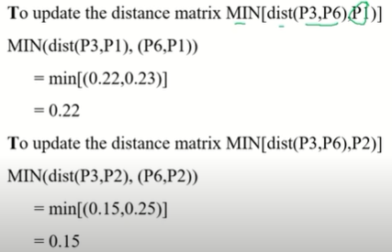
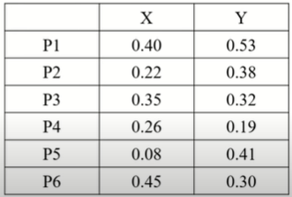
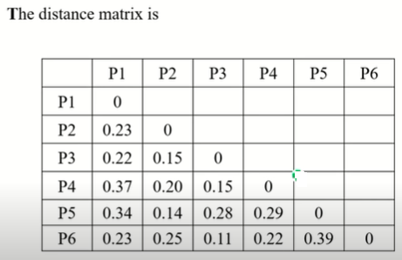
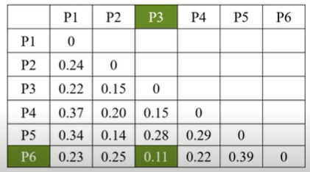

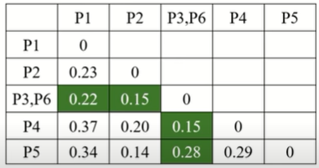
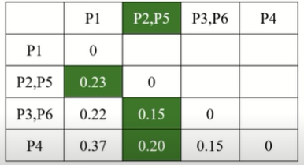
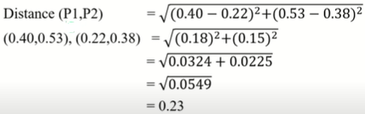
Hierarchical Clustering…
Example (Single Linkage)
Update matrix
Now matrix
Using Euclidean distance

Slide 43
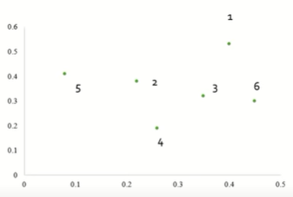
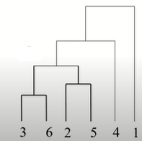


Hierarchical Clustering…
Example (Single Link)

Slide 44
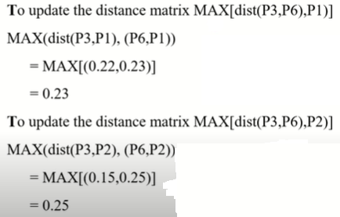
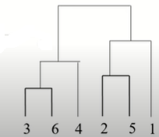
Hierarchical Clustering…
Example (Complete Link)

Slide 45
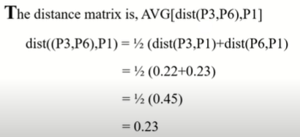
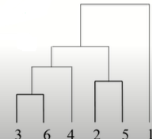
Hierarchical Clustering…
Example (Average Link)

Slide 46
Outlier Analysis
Outliers are data object different from or inconsistent with the remaining set of data
Outlier analysis is for detecting those outliers
Approaches
Statistical approach
Assume probability model for the data
Distance based approach
Objects that are substantial distance from any other clusters are considered outliers
Deviation based approach
Examine differences in the main characteristics of objects in the group

Slide 47
End of Session

